Slide 1
Dynamic Boltzmann Machine
Rajat Patel and Suyash Bagad
Indian Institute of Technology, Bombay

Slide 2
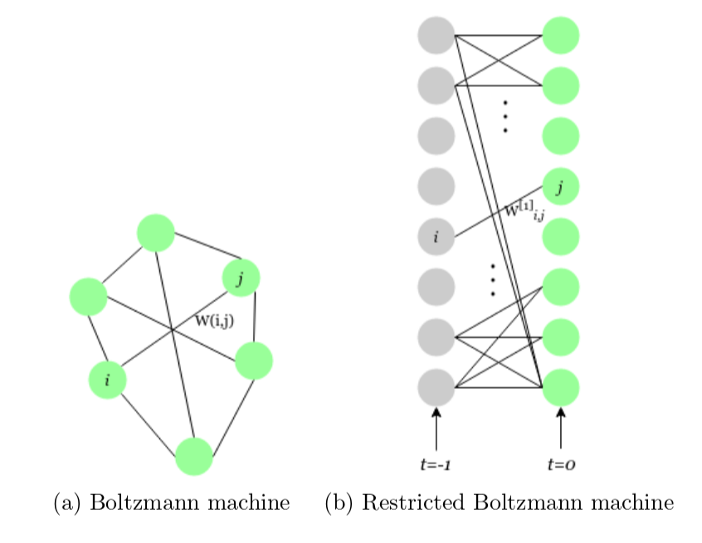
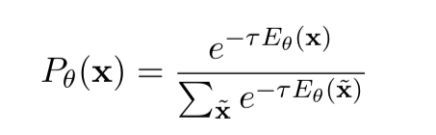
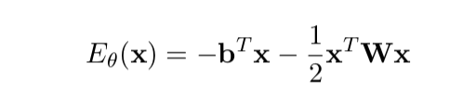

Boltzmann Machine

Slide 3
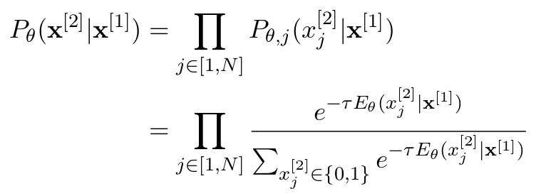

Restricted Boltzmann Machine
Train using Contrastive Divergence to get the expectation term. Time intensive!!

Slide 4
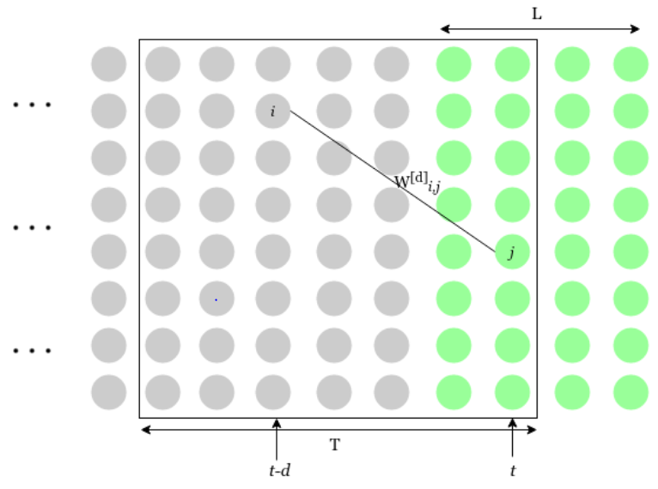


Time series Boltzmann Machine

Slide 5
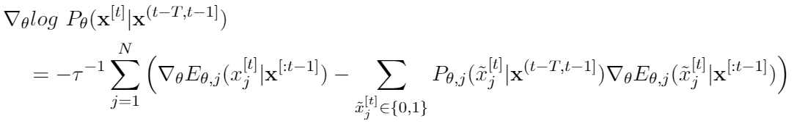
Time series Boltzmann Machine
What if we want T → ∞? Infinite no. of parameters, training becomes increasingly expensive

Slide 6
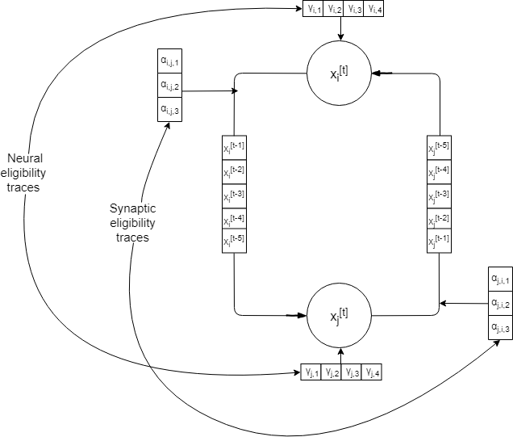
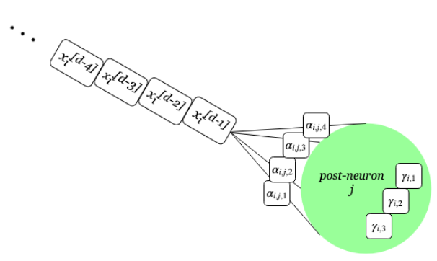
Dynamic Boltzmann Machine Structure

Slide 7
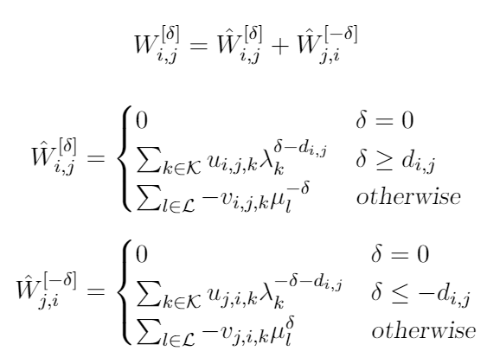
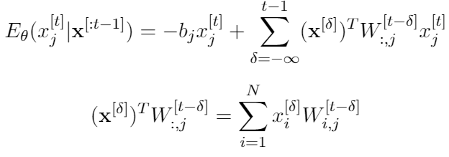
DyBM- Restrictions on Weights
Allows for T → ∞ with small no. of parameters

Slide 8
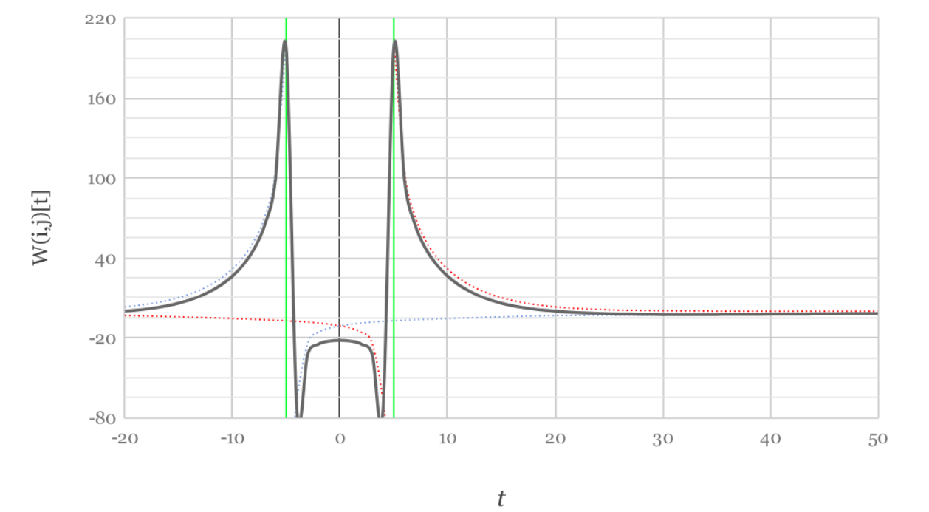
DyBM- Restrictions on Weights

Slide 9
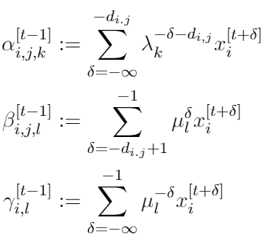
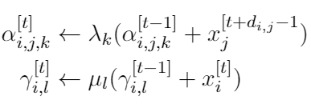
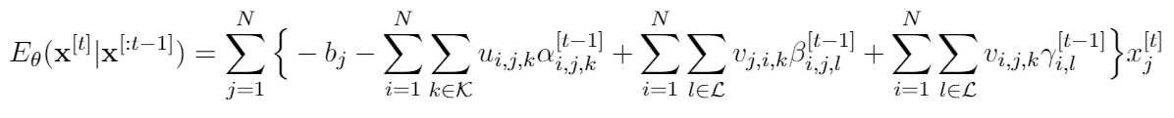
DyBM - Energy Term
𝜶- Synaptic Eligibility Trace
𝛄- Neural Eligibility Trace

Slide 10
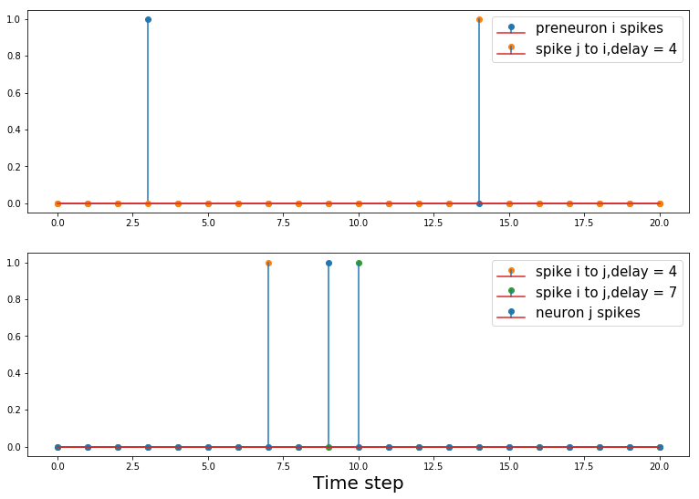
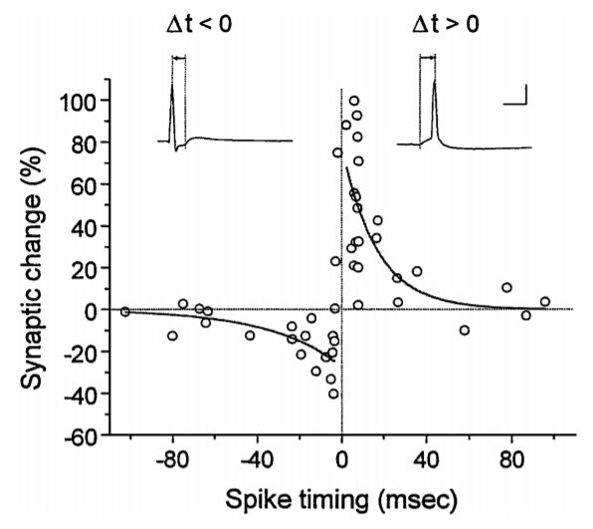
Spike Time Dependent Plasticity

Slide 11
LTP and LTD in DyBM
1st term- Higher the bias more the prob. of spiking
2nd term- LTP considering excitatory synapse(i,j)
3rd term- LTD considering excitatory synapse(i,j)
4th term- LTD considering excitatory synapse(j,i)
The reason for selecting that particular type of weight profile can be backtraced

Slide 12
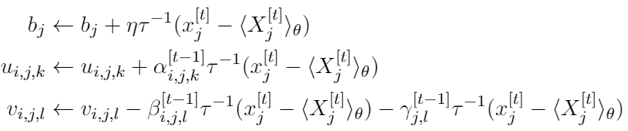
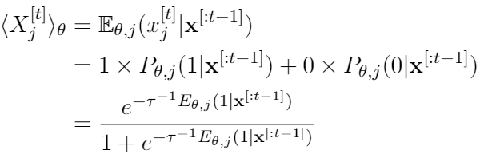
DyBM- Weight Update Equation
Weight Update is like STDP with Homeostatic Plasticity term which does not allow weights to blow up

Slide 13
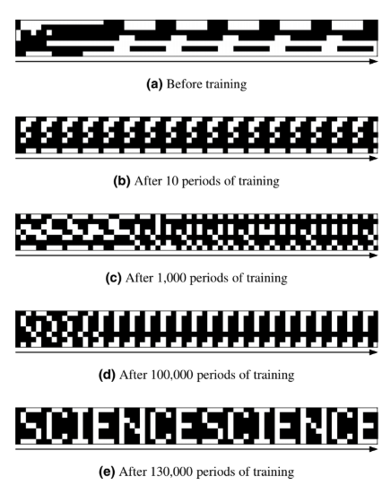
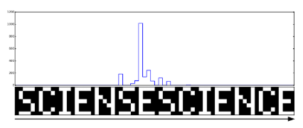
DyBM- Memorising an Image
Can memorise a sequence and detect an anomaly and its location if slightly perturbed sequence is presented

Slide 14
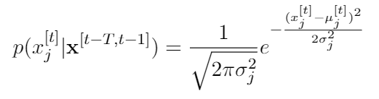
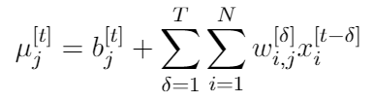
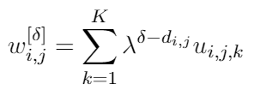
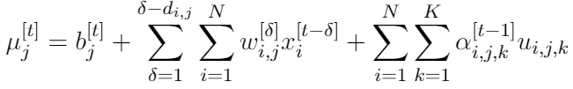

Gaussian DyBM
Neurons in DyBM can only take binary values
Extend Gaussian Boltzmann Machine to a Gaussian DyBM
Sample for a Gaussian distribution
No restriction for 𝜹 < d_{i,j} as in case of DyBM. Allows us to model G-DyBM as Extended VAR

Slide 15
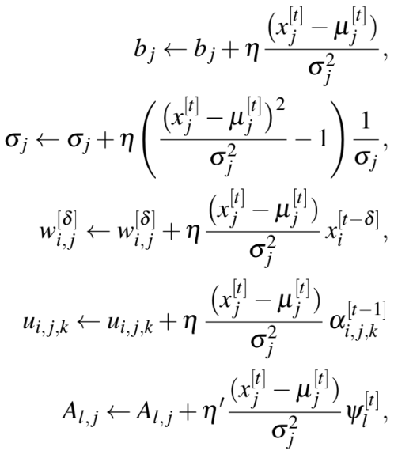

RNN Gaussian DyBM
Include a RNN layer with M dimensions for predicting bias (N dimensional) term
Helpful when time series is highly non-linear
Here RNN is similar to an echo state network

Slide 16
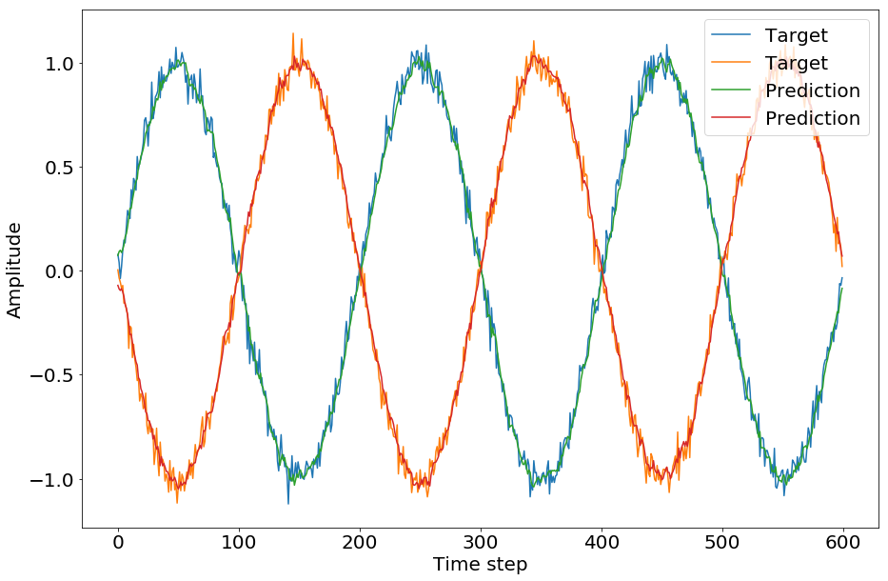
Multidimensional Sine Wave
T=200
No. of traces = 10
FIFO length=7

Slide 17
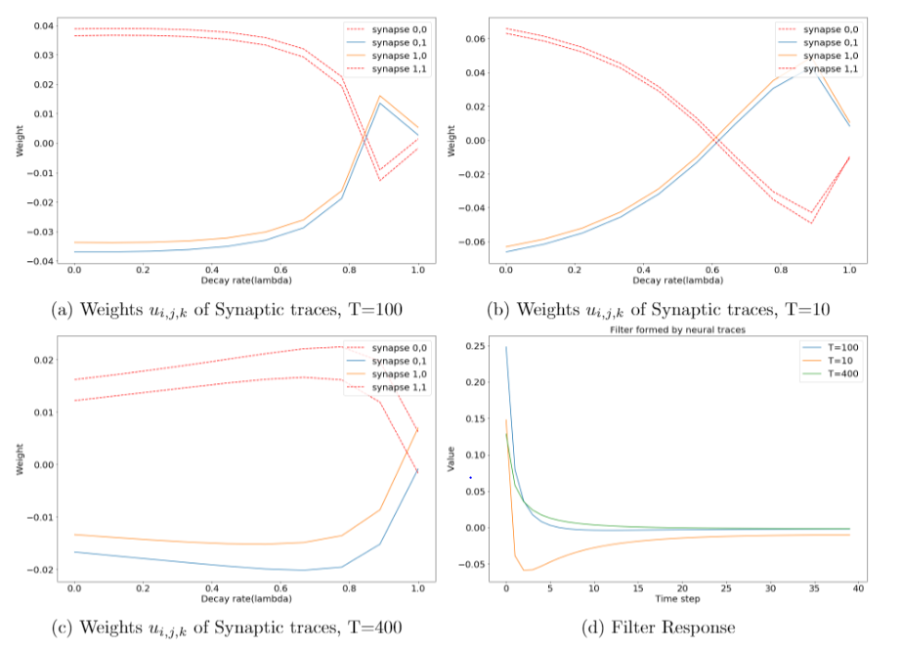

Slide 18
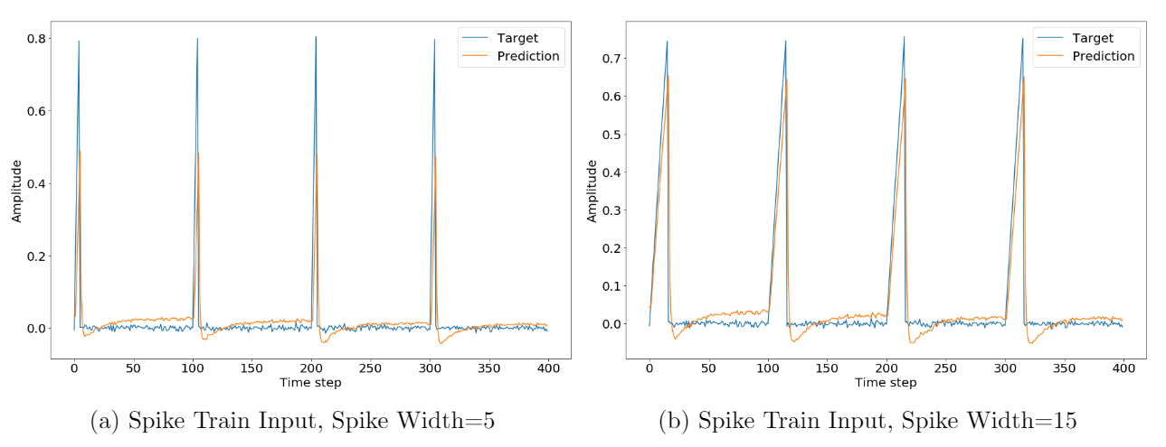
Spike Train

Slide 19
Experiments
Dataset | Variable(s) | Link
Multidimensional Noisy Sine wave | 5-dimensional sine wave with Gaussian noise | Synthetic
PACIFIC Exchange rate service (2007-2019) | Top 10 foreign currencies and INR w.r.t USD | http://fx.sauder.ubc.ca/data.html
Monthly sunspot number, Zurich (1749-1983) | Sun-spot number | http://www.sidc.be/silso/datafiles-old

Slide 20
DyBM network for experiments
#Neurons = Dim(data)
Decay = [0, 0.05, 0.16,..., 0.5]
Delay = 10-20
Index
0
1
2
Number
58.0
62.6
70.0
CAD | EUR | JPY | GBP | CHF | AUD | HKD | NZD | KRW | MXN | INR
1.1713 | 0.75911 | 117.518 | 0.51075 | 1.22278 | 1.2719 | 7.8117 | 1.44 | 941.56 | 11.1872 | 44.084
1.1753 | 0.75865 | 116.841 | 0.51397 | 1.21742 | 1.2765 | 7.8149 | 1.4519 | 943.26 | 11.1827 | 44.118
1.1811 | 0.76372 | 116.022 | 0.51992 | 1.22191 | 1.2941 | 7.8152 | 1.4743 | 951.73 | 11.1741 | 44.436

Slide 21
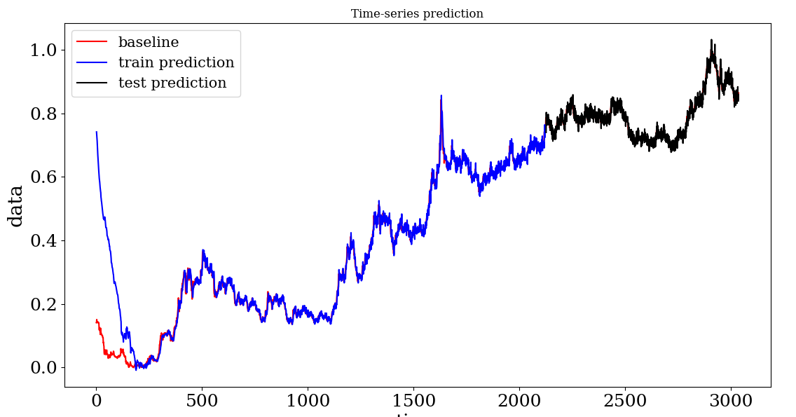
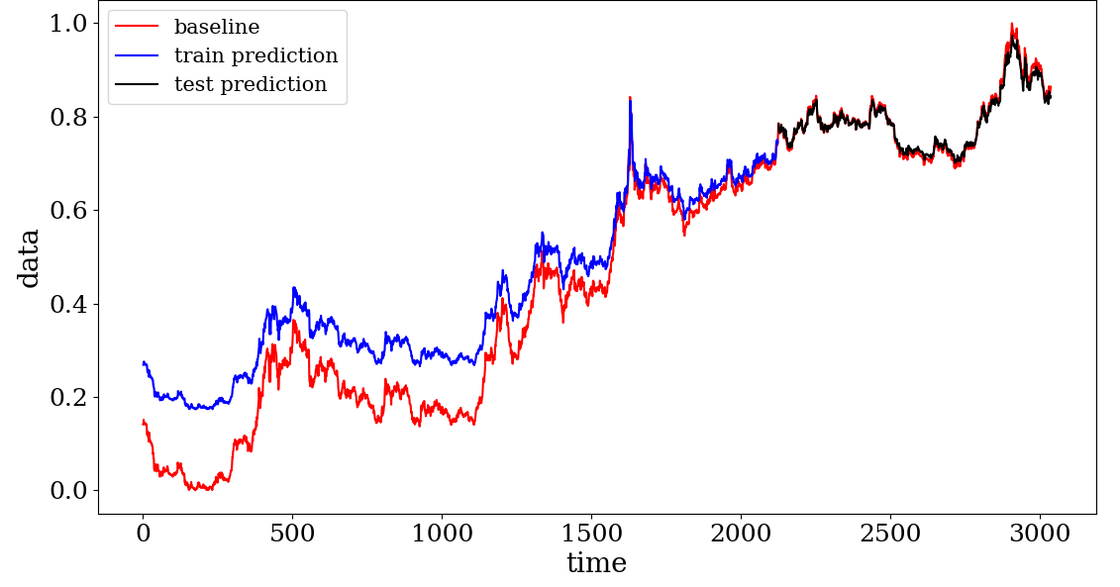
INR/USD - 2007-2019
 | DyBM | LSTM
Mean train error | 0.08196 | 0.09791
Mean test error | 0.01513 | 0.01082
Per epoch time to learn | 0.80660 | 67.41648
DyBM
LSTM

Slide 22
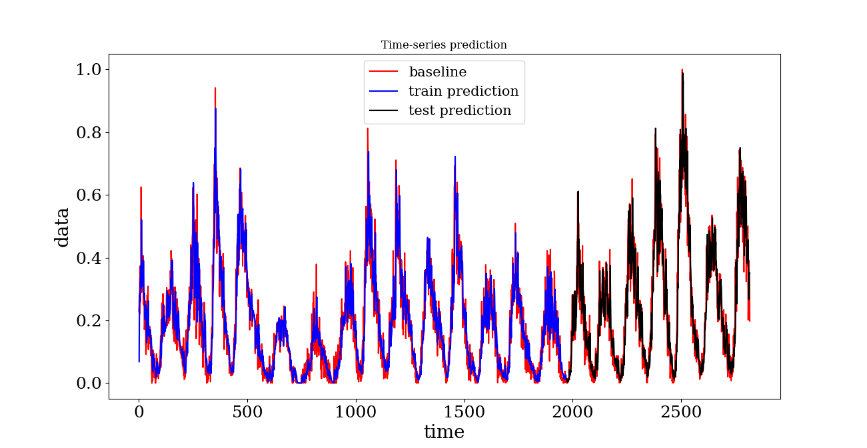
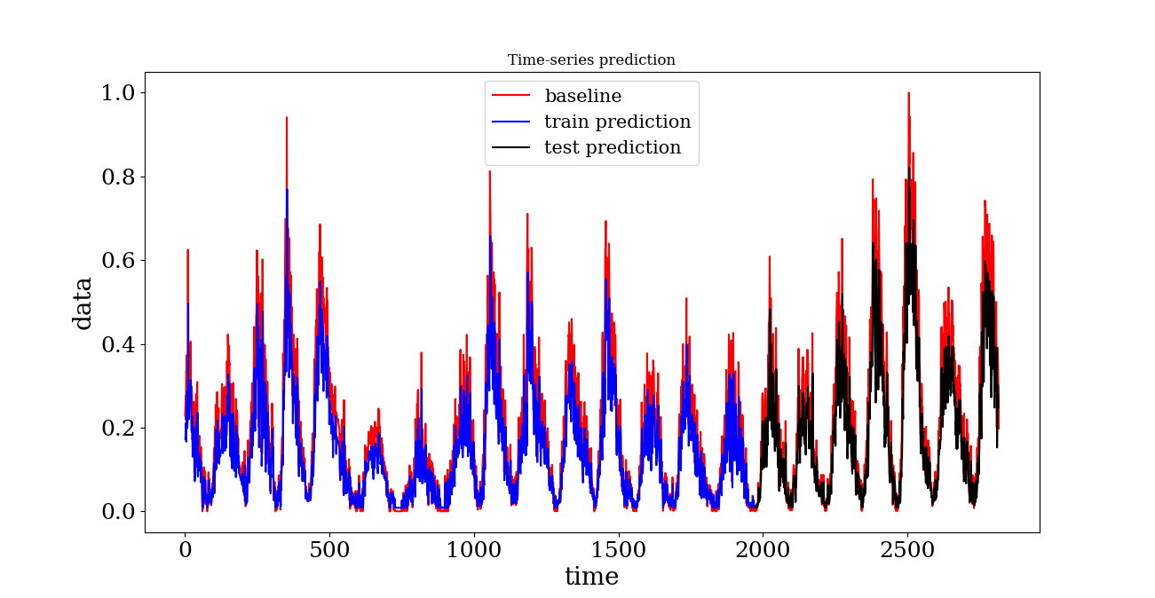
Sunspot number - Zurich
DyBM
 | DyBM | LSTM
Mean train error | 0.07036 | 0.07810
Mean test error | 0.08432 | 0.09655
Per epoch time to learn | 0.80092 | 35.33157
LSTM

Slide 23
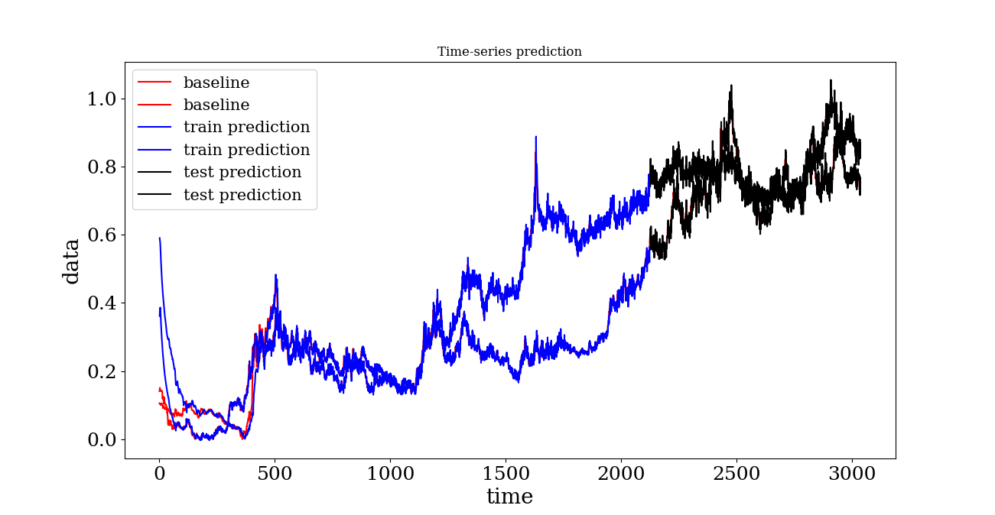
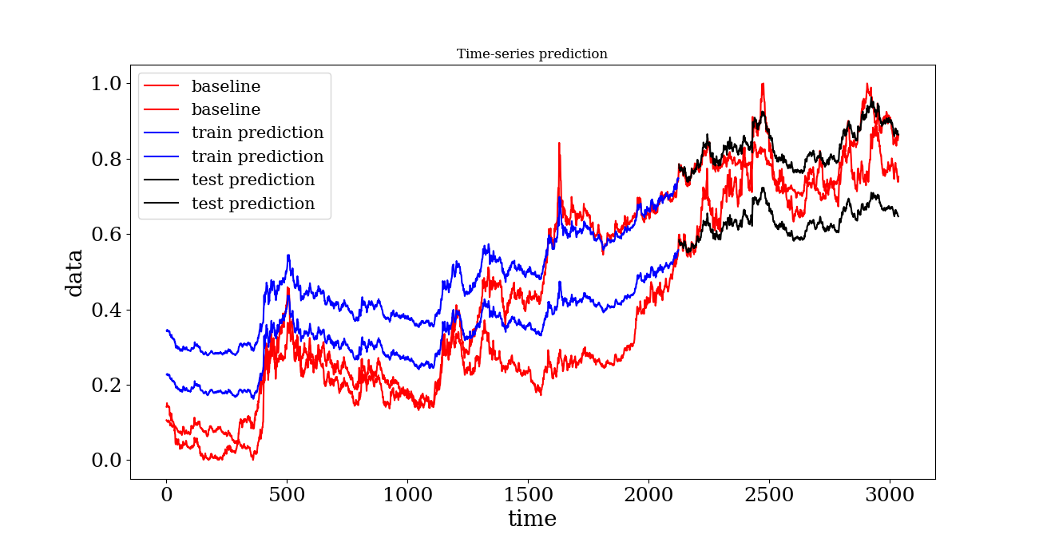
2-D time-series of exhange rates of MXN and INR
DyBM
 | DyBM | LSTM
Mean train error | 0.05623 | 0.13958
Mean test error | 0.03628 | 0.09103
Per epoch time to learn | 0.98261 | 111.95985
LSTM

Slide 24
Conclusions
DyBM learns a time-series much faster as compared to LSTM
Thus the test error is consistently better in case of DyBM
Time/epoch is always 15-25 times better in DyBM
Very few resources in DyBM as compared to LSTM framework
Customizable delay and decay in DyBM are ideal for very high-dimensional data
Predicting uncertainty of the model in its prediction
Highly suitable for online learning applications

Slide 25
Other Extensions of DyBM
Delay Pruning- Same as dropout for Artificial Neural Network
Functional DyBM- DyBM for infinite dimensonal data using gaussian process and Reproducing Hilbert kernel
Time Discounted Convolution
Second order Moments prediction
Hidden layers

Slide 26
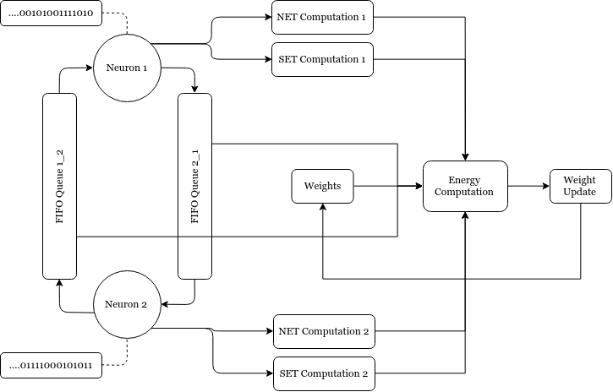
Mapping to Hardware

Slide 27
Mapping to Hardware
Buesing mapped a network of spiking neurons to a Boltzmann Machine
Neftci simulated Restricted Boltzmann Machine completely for hardware using LIF neurons and synapses
Can something similar be done with DyBM??
The weight update term already has LTP and LTD terms. How to include synaptic and neural traces?

